Slide 1
Neural Networks
BY sean Soliman & Luis Rangel

Slide 2


What is a Neural Network?

Slide 3
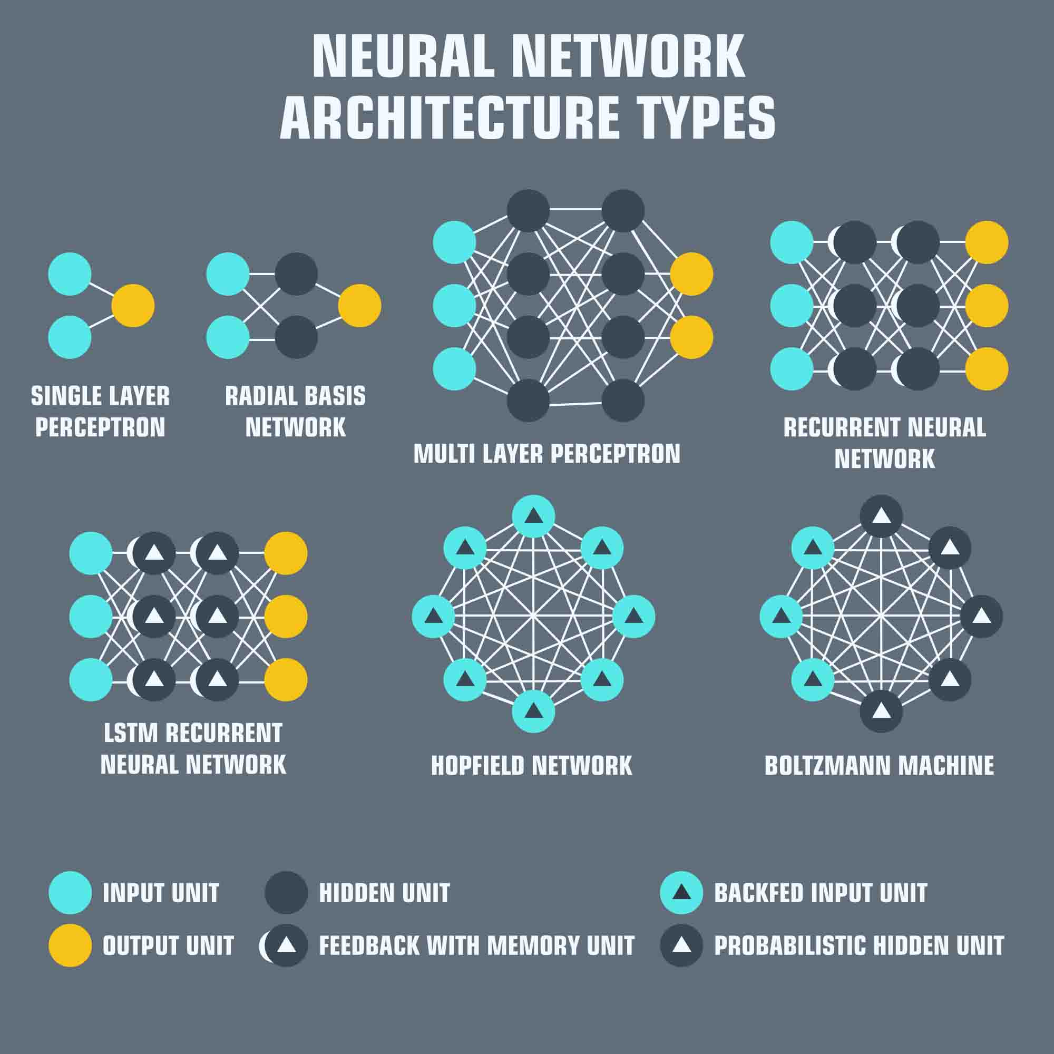
What is a Neural Network?
Neural Networks are sets of algorithms intended to recognize patterns and interpret data through a continuous learning process of clustering and labeling [1].
Characteristics:
1) Learning by example 2) Distributed associative memory 3) Fault tolerance 4) Pattern recognition [2,p.34]

Slide 4

Neural Network Architecture

Slide 5
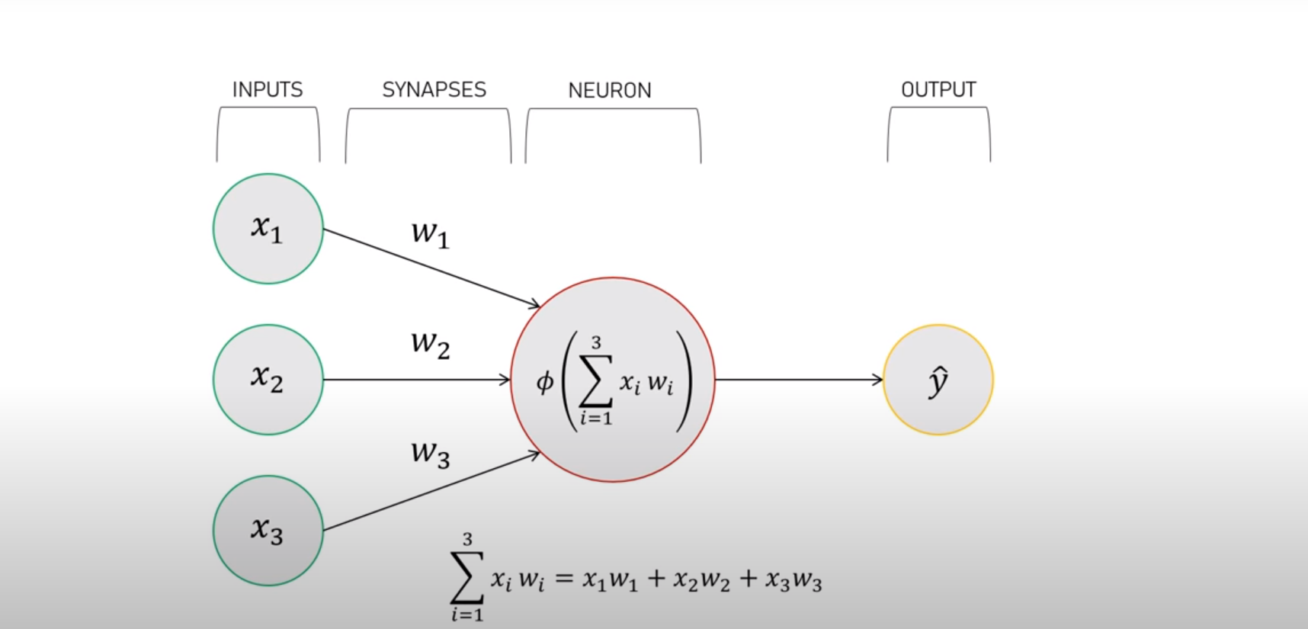
Neural Network Architecture
Things to keep in mind
Neurons (input and output)
Weights (Synapses) and Bias
Algorithms

Slide 6
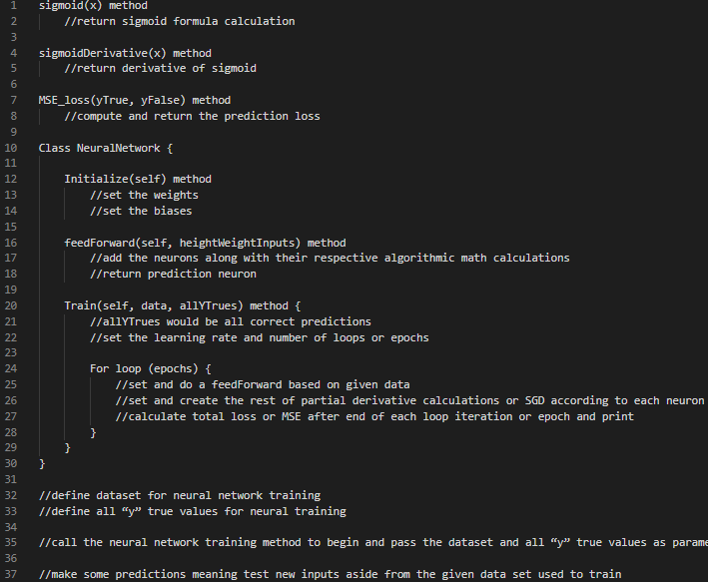
Neural Network Architecture
Pseudocode Example
More to be covered about the algorithm up next

Slide 7

Understanding the Algorithm

Slide 8
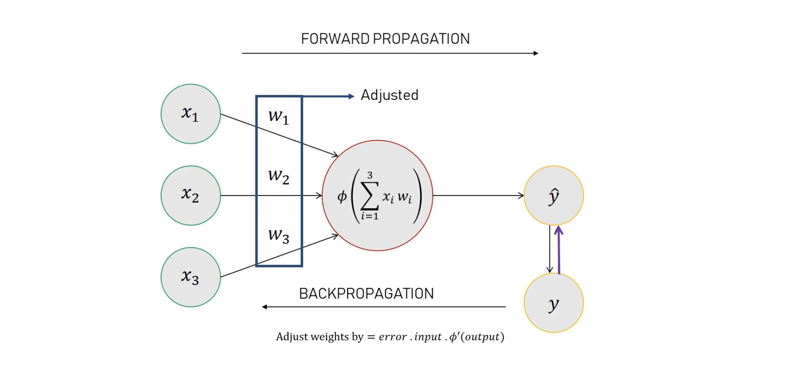
Understanding the Algorithm
Feeding and Training Process
Forward Propagation
Summation Formula
Sigmoid Function
Backward Propagation [3,p.63]
Mean Squared Error (MSE)
Stochastic Gradient Descent (SGD)

Slide 9
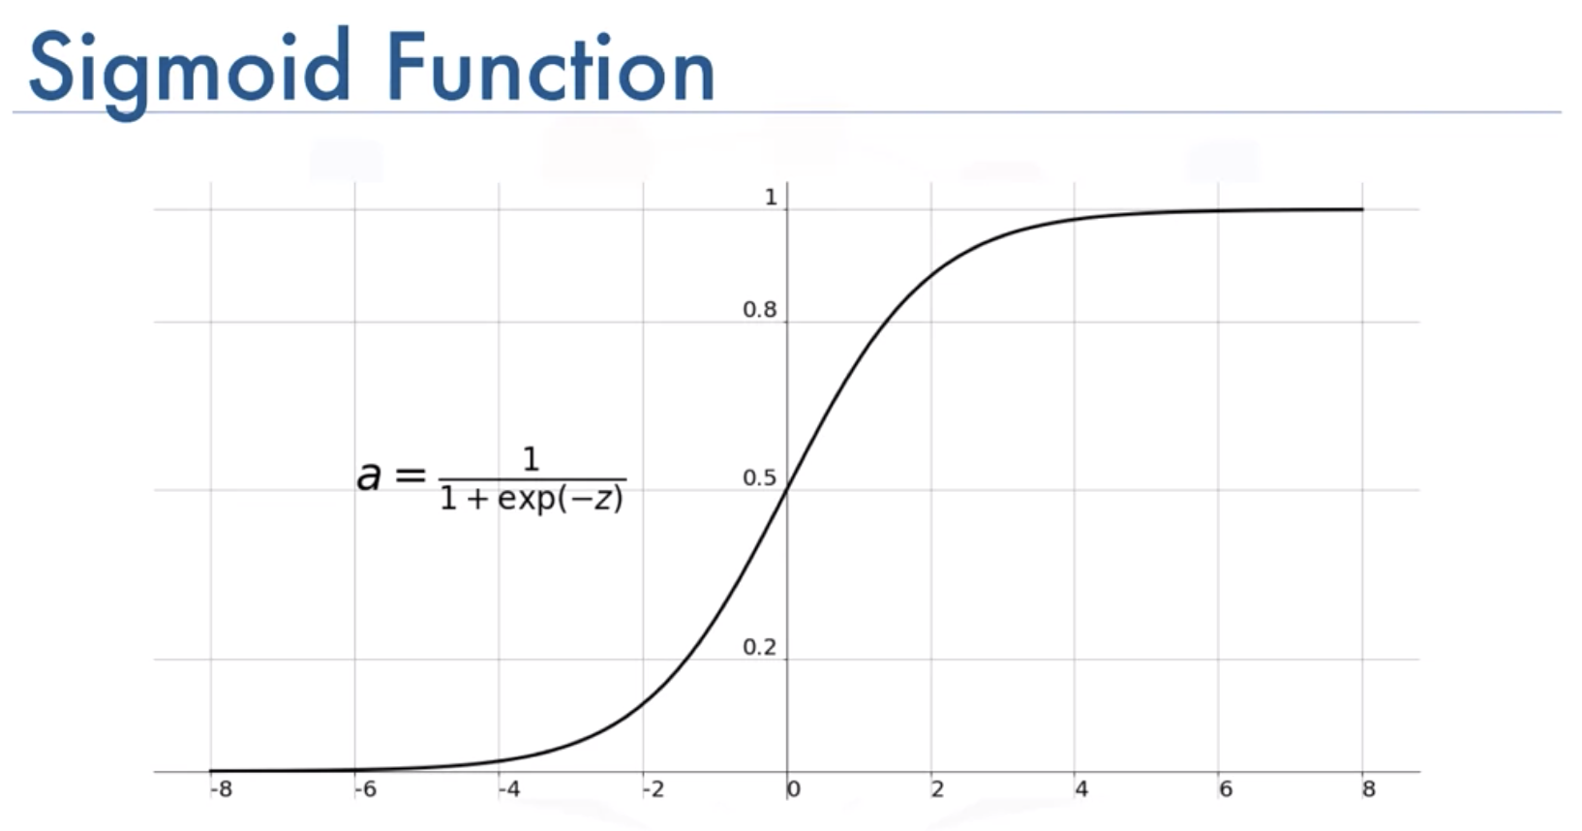

How it works?
Forward Propagation – Summation Example with Sigmoid Function
h1 = $f$(w1x1 + w2x2 + b1)
= $f\left(−2−1+0\right)$
= $0.0474$
h2 = $f$(w3x1 + w4x2 + b2)
= $0.0474$
O1 = $f$(w5h1 + w4h2 + b3)
= $f\left(0.0474+0.0474+0\right)$
= 0.524

Slide 10

How it works?
Backward Propagation – MSE Example
MSE = $\frac{1}{n} \sum_{i=1}^{n}{(y_{true}−y_{pred})}$
= $\frac{1}{4}$ (1+0+1+0)
= 0.5
Backpropagation – SGD
W1 ← W1 - $η\frac{∂L}{∂w_{1}}$ (Adjusting Weights)
$η$ = learning rate constant
$\frac{∂L}{∂w_{1}}$ = Partial derivative for Loss (MSE) and weight

Slide 11

Simple Neural Network Example

Slide 12
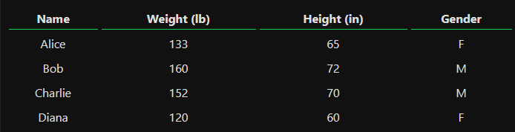
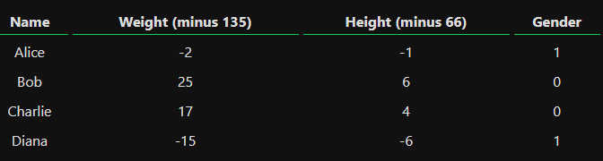
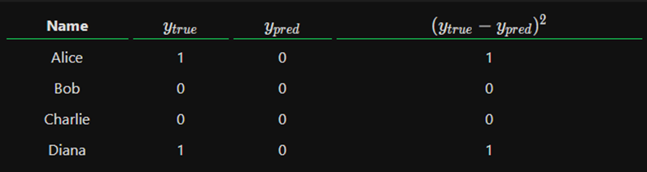
Simple Neural Network Example
Finding a person’s gender based on height and weight by performing training first
Adding inputs from the data set on the right
Female is 1 and Male is 0 for true
Applying the algorithm mentioned previously using the data set
Looping through the algorithm 1000 times in order to reduce the MSE
Predictions will change until we reach the end of the loop as it continuously forward and back propagates based upon the change from the MSE reduction

Slide 13
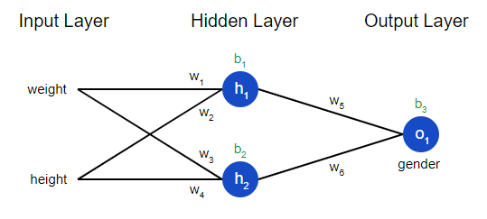
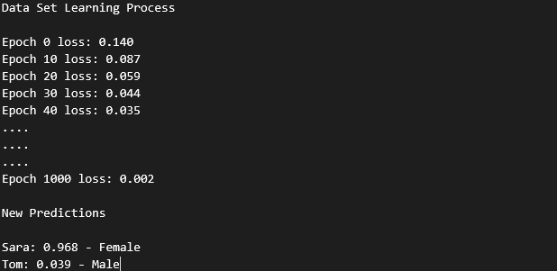
Simple Neural Network Example
Brief Summary of Results
First loop calculates a 0.140 loss for the MSE
After finishing the loop, the loss results into 0.002
Next time we only feedforward new individuals, such as Sara and Tom, our predictions will result much more accurately after it applies our new 0.002 MSE.
Sara: 128 pounds, 63 inches
Tom: 155 pounds, 68 inches

Slide 14

Basics Summary

Slide 15
Basics Summary
Continuous Training
Neural Network will not always output accurate results every time
Program will still loop several times until MSE becomes low
Training takes time for it to become as optimal as possible through the continuous forward and back propagations

Slide 16

Where it can be applied?

Slide 17
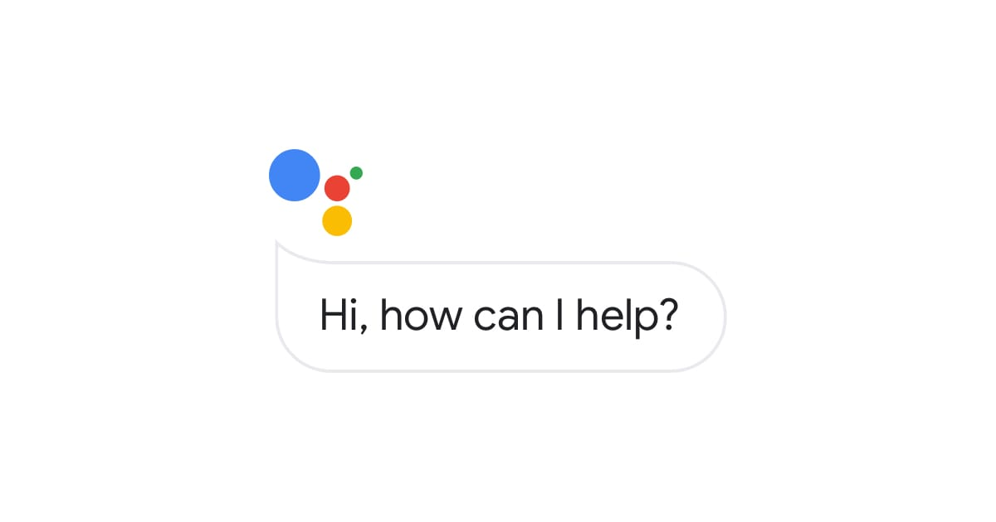
Where it can be applied
Language Translating
Music Composition
Video Games
Sales Forecasting
Facial Recognition
And many more…

Slide 18

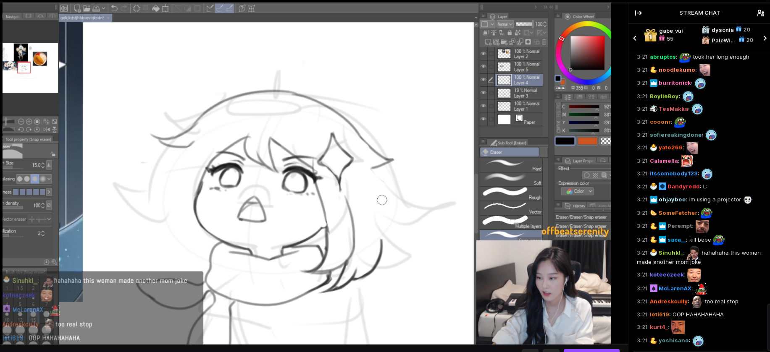
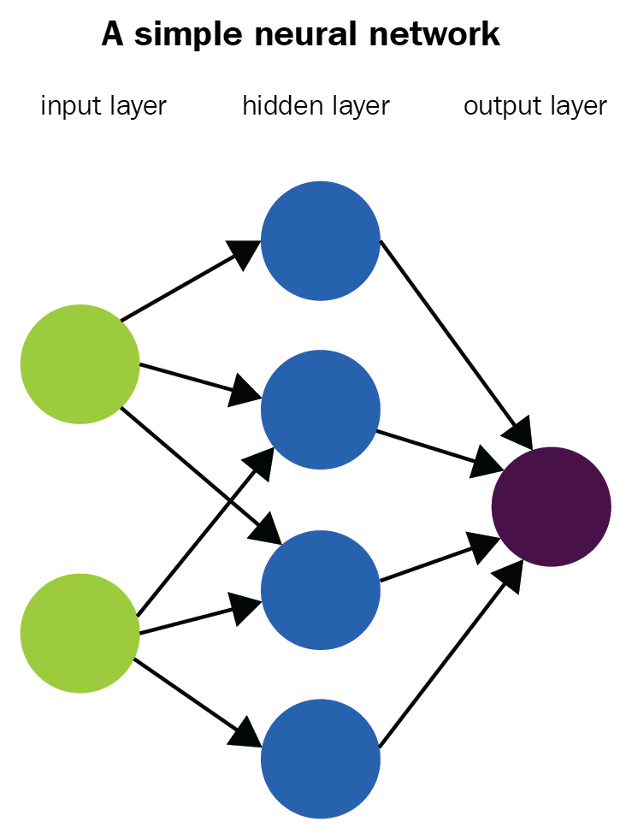
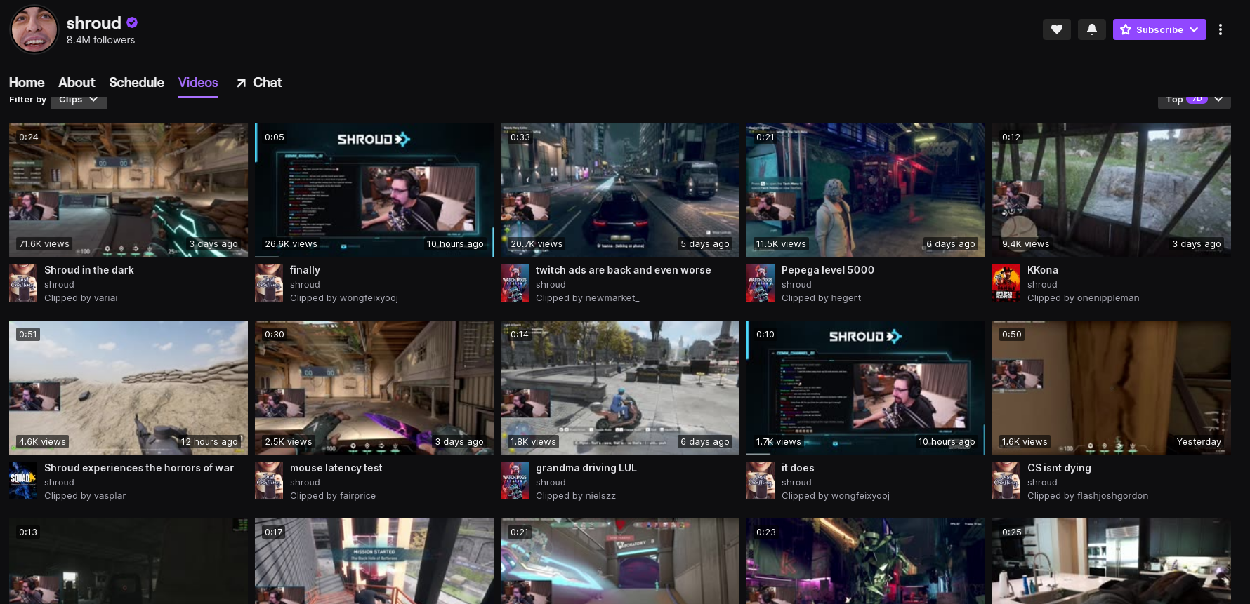
Predict Twitch clip category

Slide 19

Twitch
www.Twitch.tv live streaming service
Ability to interact with one another
Twitch’s chat system.
“The chat is an important part of the video game livestreaming experience…”[4,p. 3]
“As of 2018, Twitch had more than 3.2 million independent broadcasters and 45 billion minutes watched per month.” [5,p.147]

Slide 20
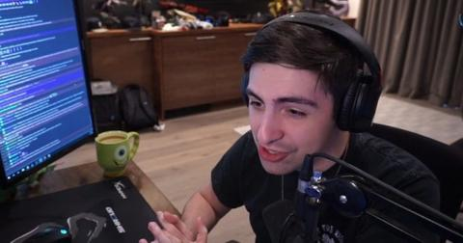
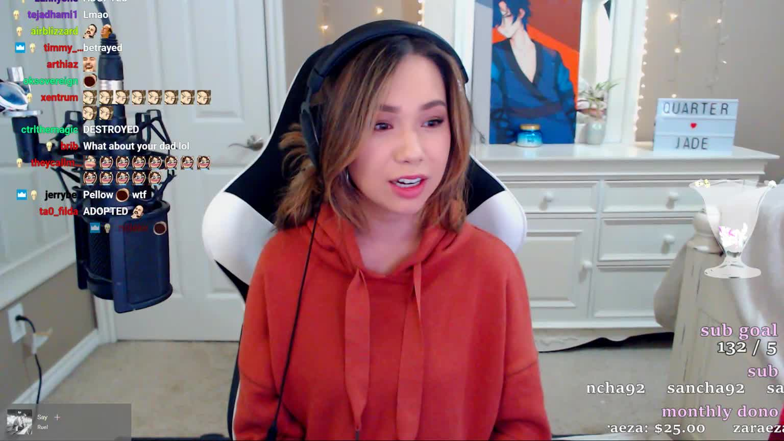
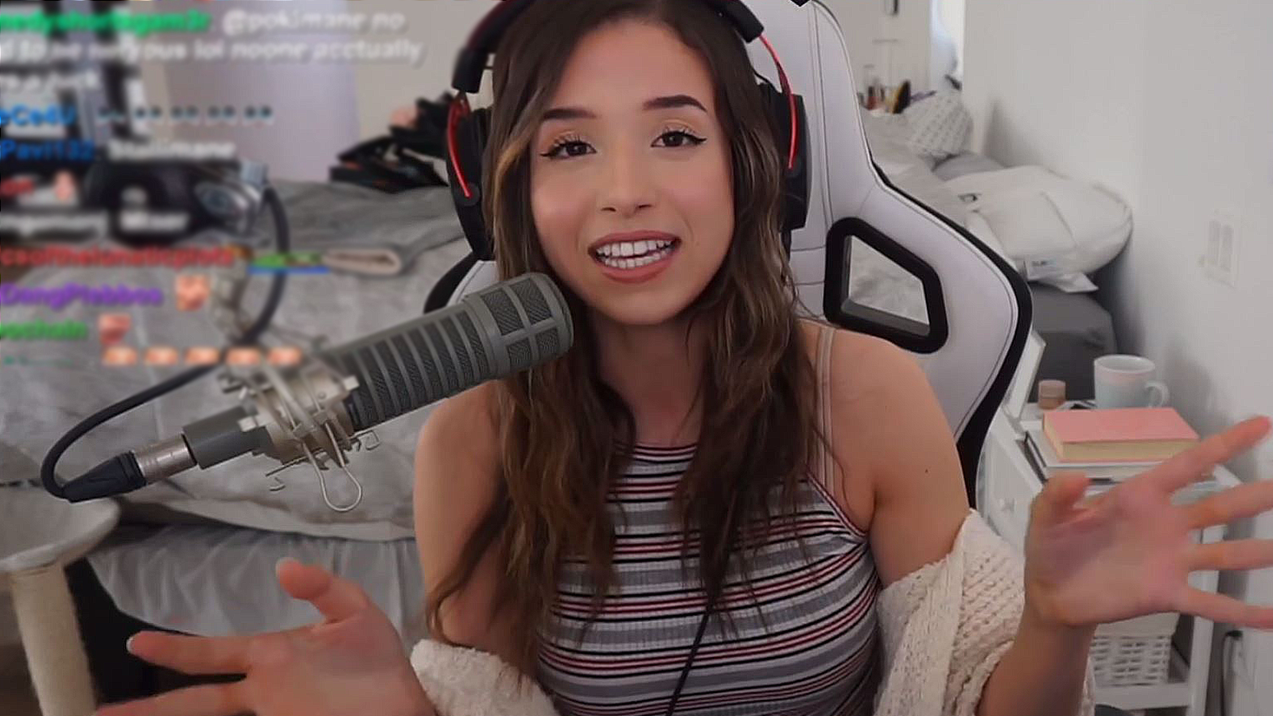
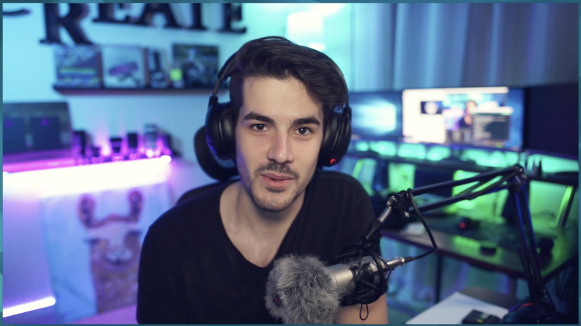
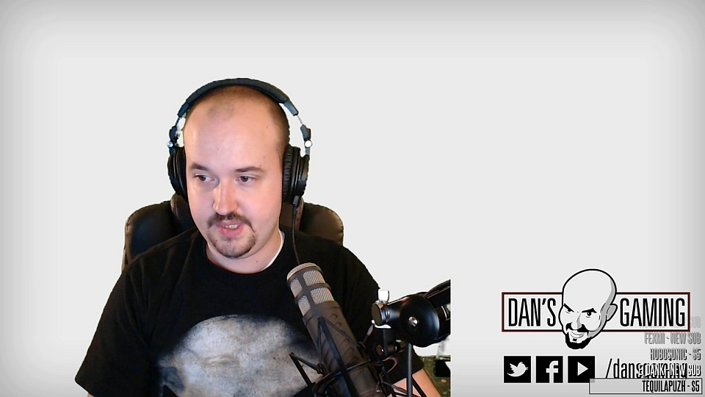
Streamers
Twitch revolves around its streamers
Livelihood/job out of streaming
Streamers = content creators
Twitch content to YouTube to further monetize their content.
Twitch clips = big importance

Slide 21
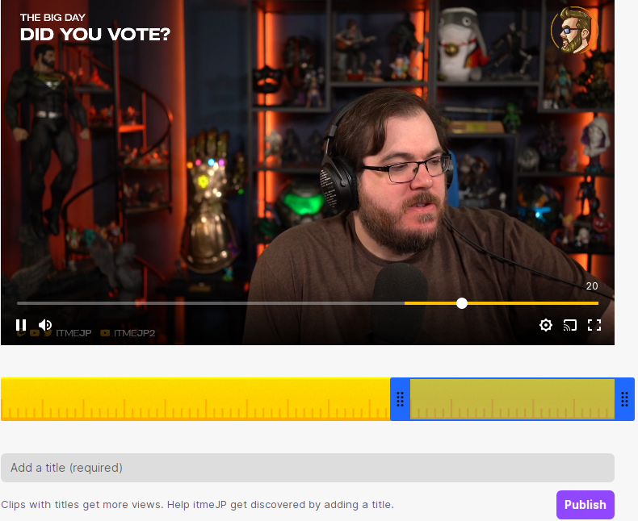
Problem: Twitch Clips Category
Functionality to clip stream
However, can’t determine clip category
Plenty of wasted potential clips
Clips would be of more use for both the viewer and streamer if they were able to be categorized

Slide 22
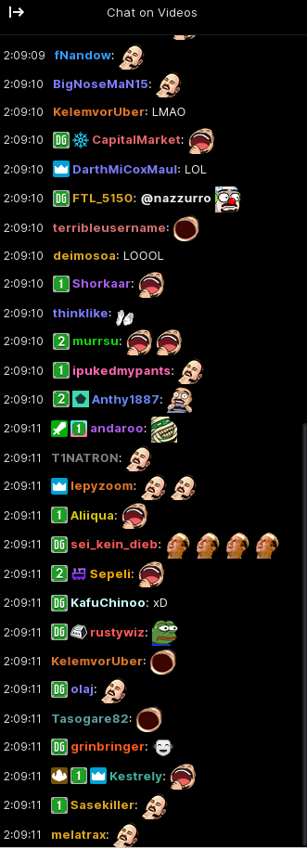
Solution: Neural Networks and Twitch Clips
+
Utilizing Twitch clip’s chat to determine a category for the clip.
INPUT LAYER: Twitch clip chat log
HIDDEN LAYER: Keywords detected
Funny: “funny, hilarious, lol, lul, haha,, omegalul” etc.
Amazing/Epic: “Amazing, epic, wow, cool, pogchamp, pog, poggers, ez”
Sad: “sad, aww, :(, noo, biblethump, FeelsBadMan
OUTPUT LAYER: “This video is likely to be x”

Slide 23
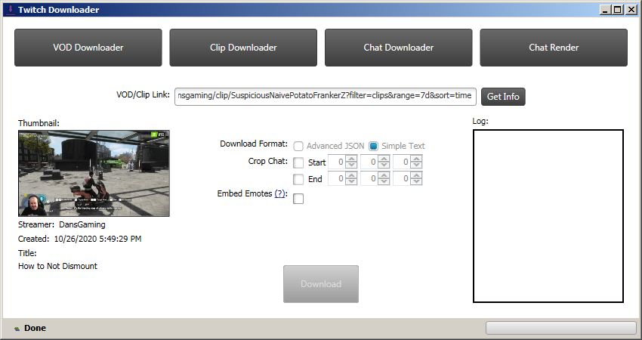
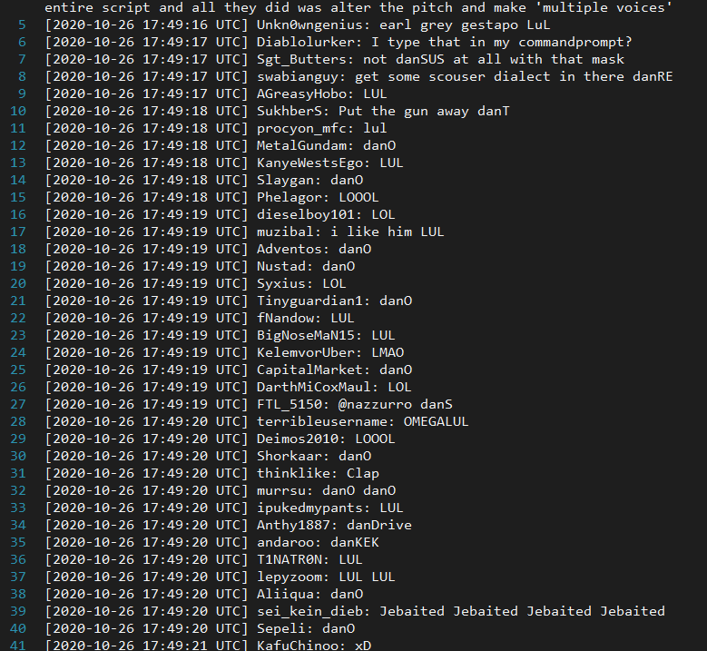
Dataset
Chat logs from clipped twitch videos
Obtained from “TwitchDownloader” program
TwitchDownloader: https://github.com/lay295/TwitchDownloader
Characteristics of our dataset include:
Username, timestamp, and message[6,p.1810]
We however only make use of their message/response.

Slide 24
Tools
TwitchDownloader
Used to grab clip log
TwitchDownloader: https://github.com/lay295/TwitchDownloader
Python packages
Numpy: https://numpy.org/
Keras: https://keras.io/
Scikit: https://scikit-learn.org/stable/
Tensorflow: https://www.tensorflow.org/
Premade Neural Network samples
https://github.com/jonasbostoen/simple-neural-network
https://github.com/jg-fisher/diabetesNeuralNetwork

Slide 25
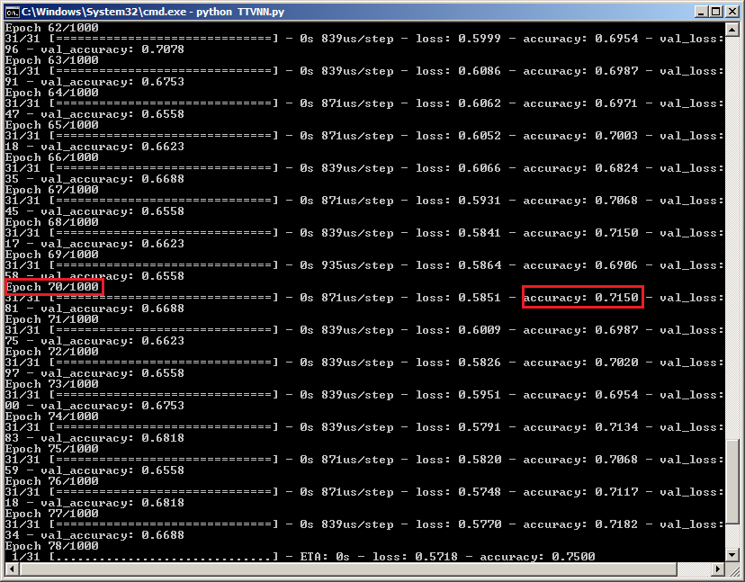
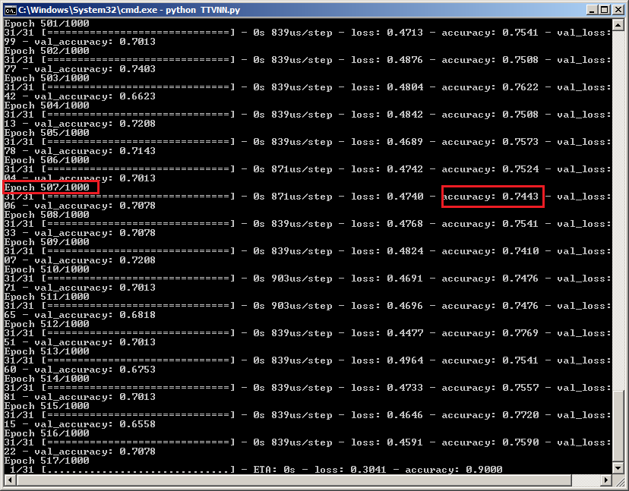
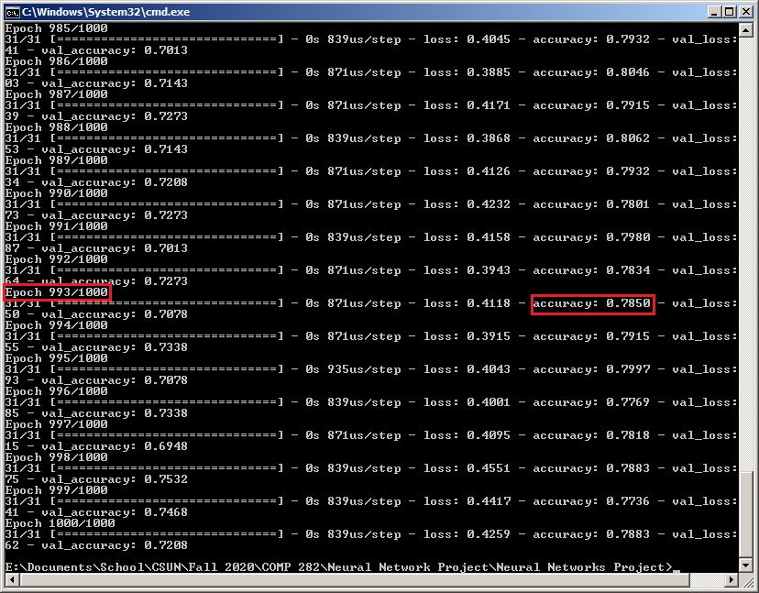
Example Result
More training = greater accuracy

Slide 26
Our Results
Issues:
Twitch network technology:
Stream latency delay can potentially effect clip’s chat [7, p. 1184 ]
Accuracy because of dependency:
Amount of training for neural network
Relies on user to type certain keywords
No typical/conventional “dataset” that we could find for our application since our approach is new, so we picked 30 random twitch clip chat logs from different users to run on a neural network.
Neural network model to reduce errors through training(back propagation)
The more training -> lesser the errors

Slide 27
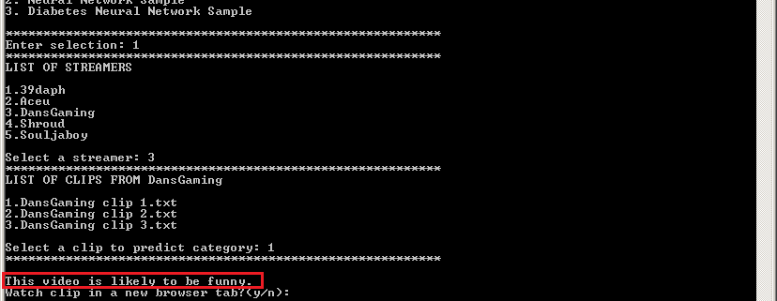
Results

Slide 28
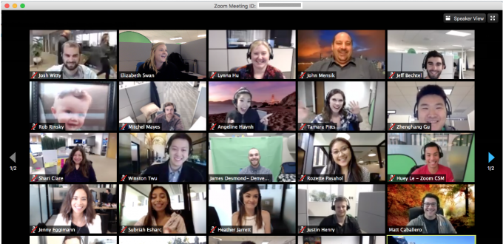
Contribution
A potential contribution would be towards implementation on remote learning. With a majority of schools/classes being taught online the use of neural networks could benefit.
In this scenario, neural networks can be used as a tool for prediction in multiple ways such as:
Highlighting important topics that are covered during instructional learning and meetings.

Slide 29

Comparisons and conclusions
Many types of Neural Networks available
Each Pros and cons
Example:
Universal Language Model Fine-tuning (ULMFiT) model outperforming two other Deep Neural Networks in detection of hate words on Twitter.[8]

Slide 30
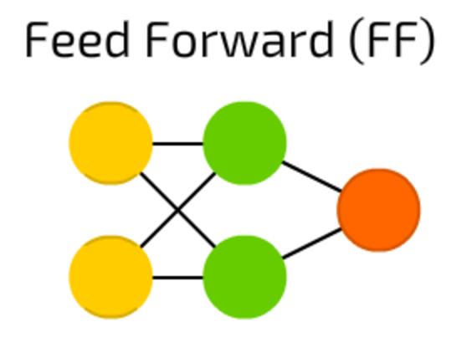
Feed Forward (FF) Neural Network [9]
All nodes are fully connected
Activation flows from input layer to output, without back loops
There is one layer between input and output (hidden layer)

Slide 31
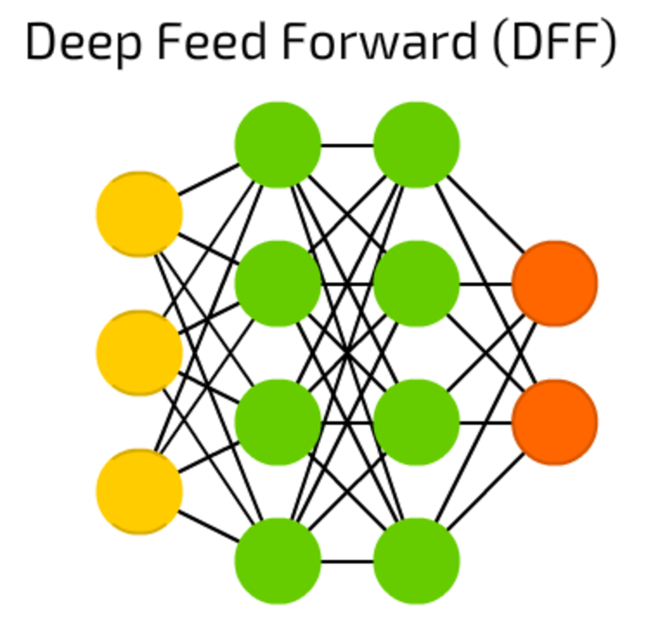
Deep Feed Forward (DFF) Neural Network
Stacking/more layers
Exponential growth in training times
Good for high accuracy[10]

Slide 32
Reference List
[1] Ketkar, Nikhil. Deep Learning with Python: A Hands-on Introduction. 1st ed., Apress : Imprint: Apress, 2017.
[2] R. E. Uhrig, "Introduction to artificial neural networks," Proceedings of IECON '95 - 21st Annual Conference on IEEE Industrial Electronics, Orlando, FL, USA, 1995, pp. 33-37 vol.1, doi: 10.1109/IECON.1995.483329.
[3] E. Vonk, L. C. Jain and L. P. J. Veelenturf, "Neural network applications," Proceedings Electronic Technology Directions to the Year 2000, Adelaide, SA, Australia, 1995, pp. 63-67, doi: 10.1109/ETD.1995.403490.
[4] G. Nascimento et al., "Modeling and Analyzing the Video Game Live-Streaming Community," 2014 9th Latin American Web Congress, Ouro Preto, 2014, pp. 1-9, doi: 10.1109/LAWeb.2014.9.
[5] J. Kim, K. Park, H. Song, J. Y. Park and M. Cha, "Learning How Spectator Reactions Affect Popularity on Twitch," 2020 IEEE International Conference on Big Data and Smart Computing (BigComp), Busan, Korea (South), 2020, pp. 147-154, doi: 10.1109/BigComp48618.2020.00-84.
[6] R. Jiang, C. Qu, J. Wang, C. Wang and Y. Zheng, "Towards Extracting Highlights From Recorded Live Videos: An Implicit Crowdsourcing Approach," 2020 IEEE 36th International Conference on Data Engineering (ICDE), Dallas, TX, USA, 2020, pp. 1810-1813, doi: 10.1109/ICDE48307.2020.00176.
[7] X. Ma, C. Zhang, J. Liu, R. Shea and D. Fu, "Live Broadcast With Community Interactions: Bottlenecks and Optimizations," in IEEE Transactions on Multimedia, vol. 19, no. 6, pp. 1184-1194, June 2017, doi: 10.1109/TMM.2016.2646182.
[8] B. R. Amrutha and K. R. Bindu, "Detecting Hate Speech in Tweets Using Different Deep Neural Network Architectures," 2019 International Conference on Intelligent Computing and Control Systems (ICCS), Madurai, India, 2019, pp. 923-926, doi: 10.1109/ICCS45141.2019.9065763.
[9] C. Zhang and W. Xu, "Neural networks: Efficient implementations and applications," 2017 IEEE 12th International Conference on ASIC (ASICON), Guiyang, 2017, pp. 1029-1032, doi:10.1109/ASICON.2017.8252654.
[10] P. Khuphiran, P. Leelaprute, P. Uthayopas, K. Ichikawa and W. Watanakeesuntorn, "Performance Comparison of Machine Learning Models for DDoS Attacks Detection," 2018 22nd International Computer Science and Engineering Conference (ICSEC), Chiang Mai, Thailand, 2018, pp. 1-4, doi: 10.1109/ICSEC.2018.8712757.

